Slide 1


SMART INDIA HACKATHON 2026
Problem Statement ID – PS7
Problem Statement Title- AI‑Powered UI Generator for CMS‑Bound Interfaces
Theme- Software Innovation
PS Category- Software
Team ID- T27
Team Name - NEXUS

Slide 2


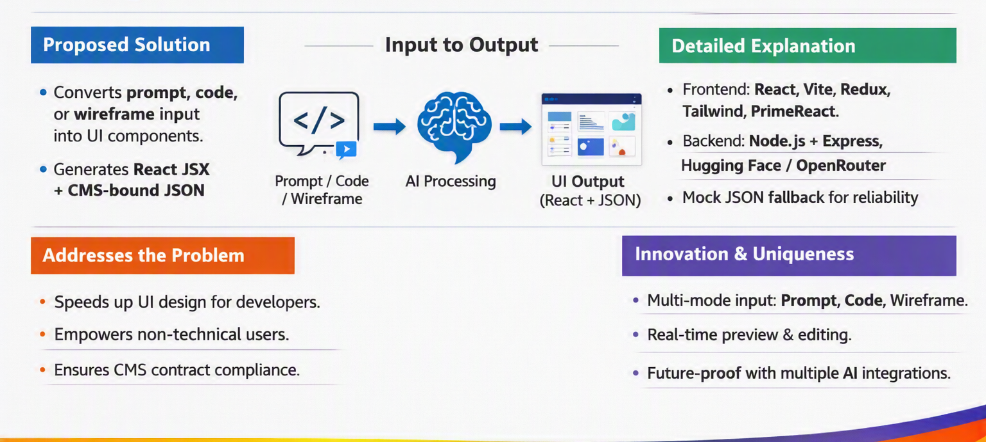
UIForge: AI‑Powered UI Generator
NEXUS

Slide 3
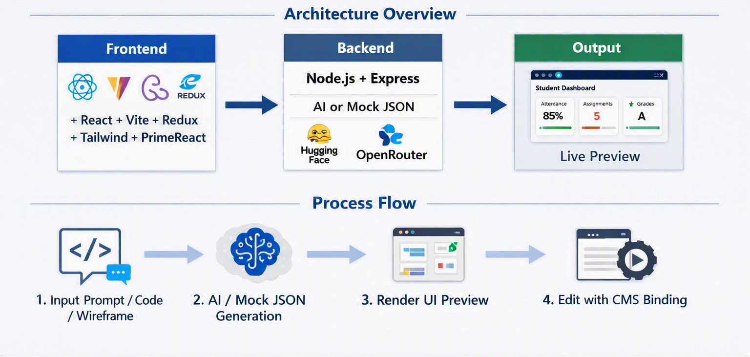
NEXUS
TECHNICAL APPROACH

Slide 4
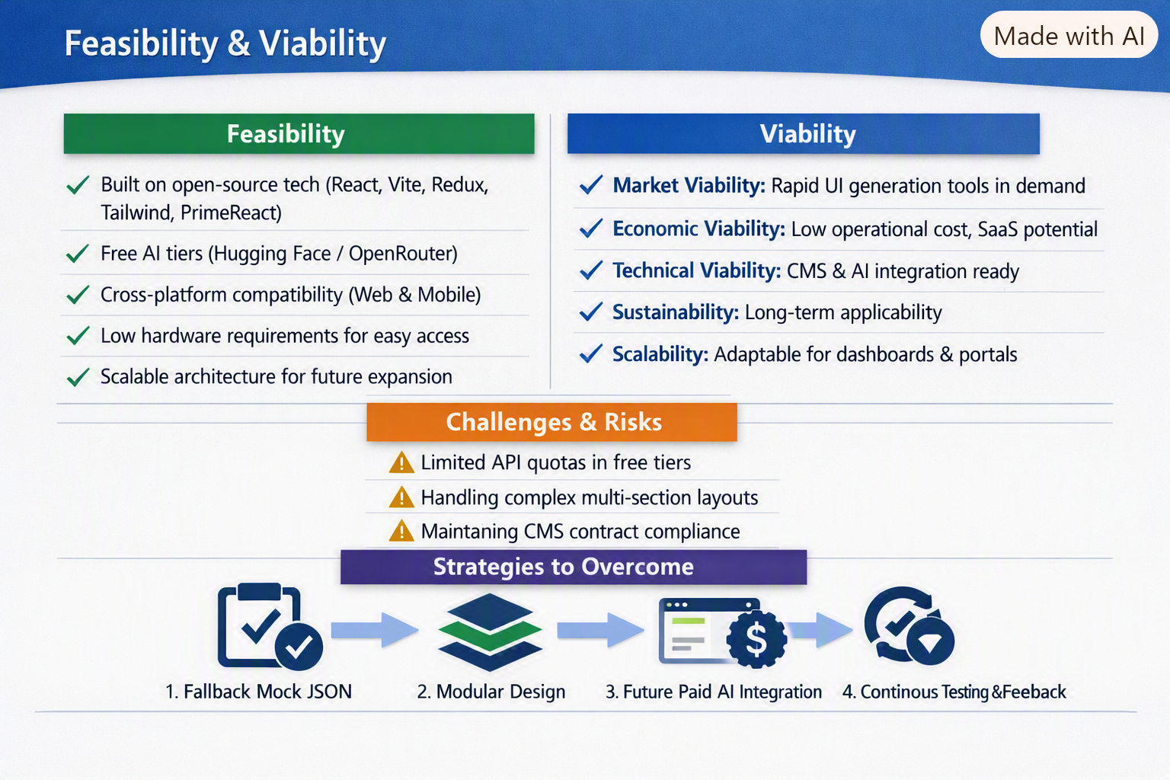
NEXUS
FEASIBILITY AND VIABILITY

Slide 5
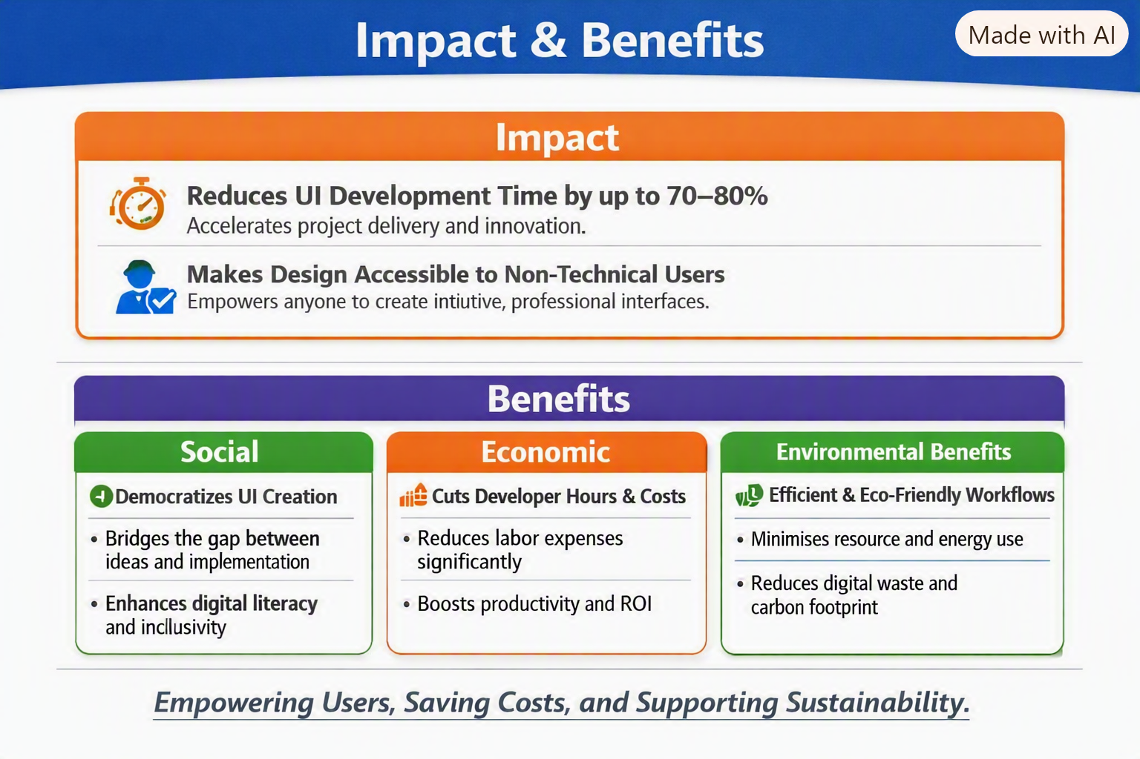
IMPACT AND BENEFITS
NEXUS

Slide 6

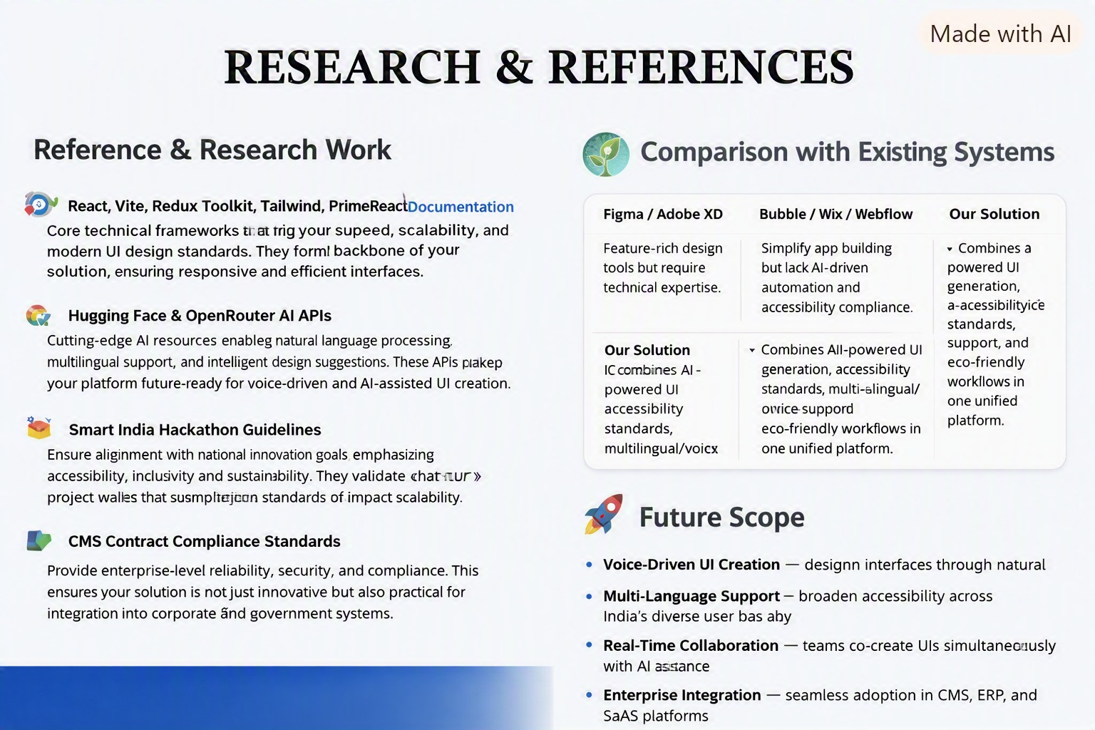

NEXUS
Documentation

Slide 7

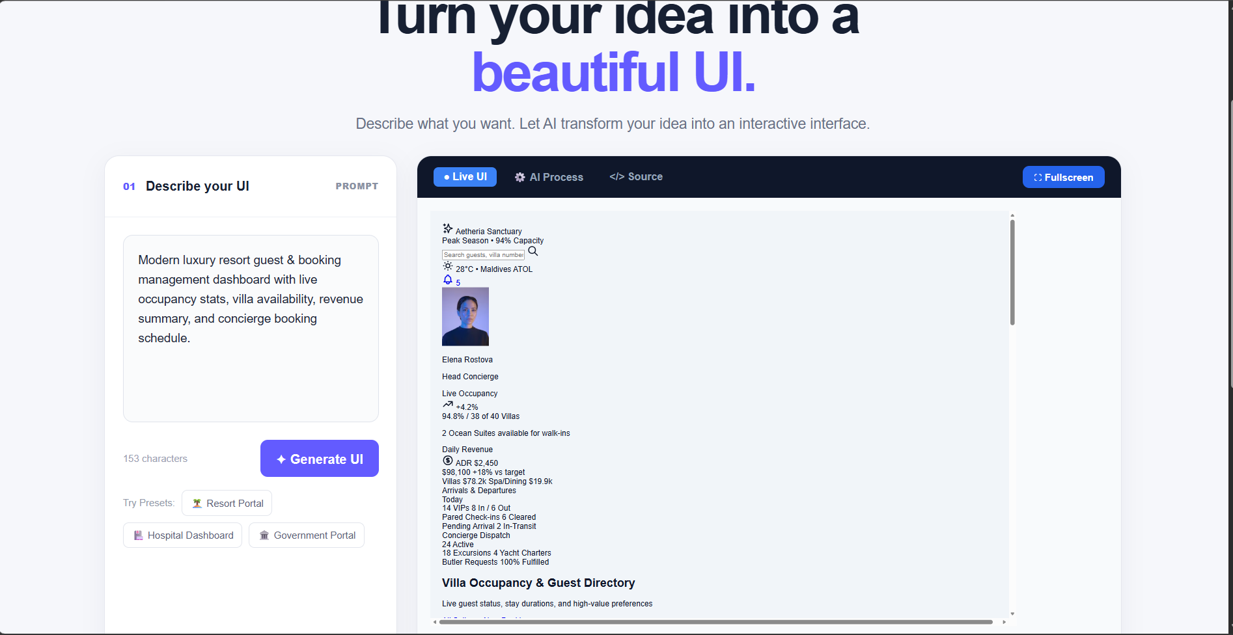
NEXUS

Slide 8
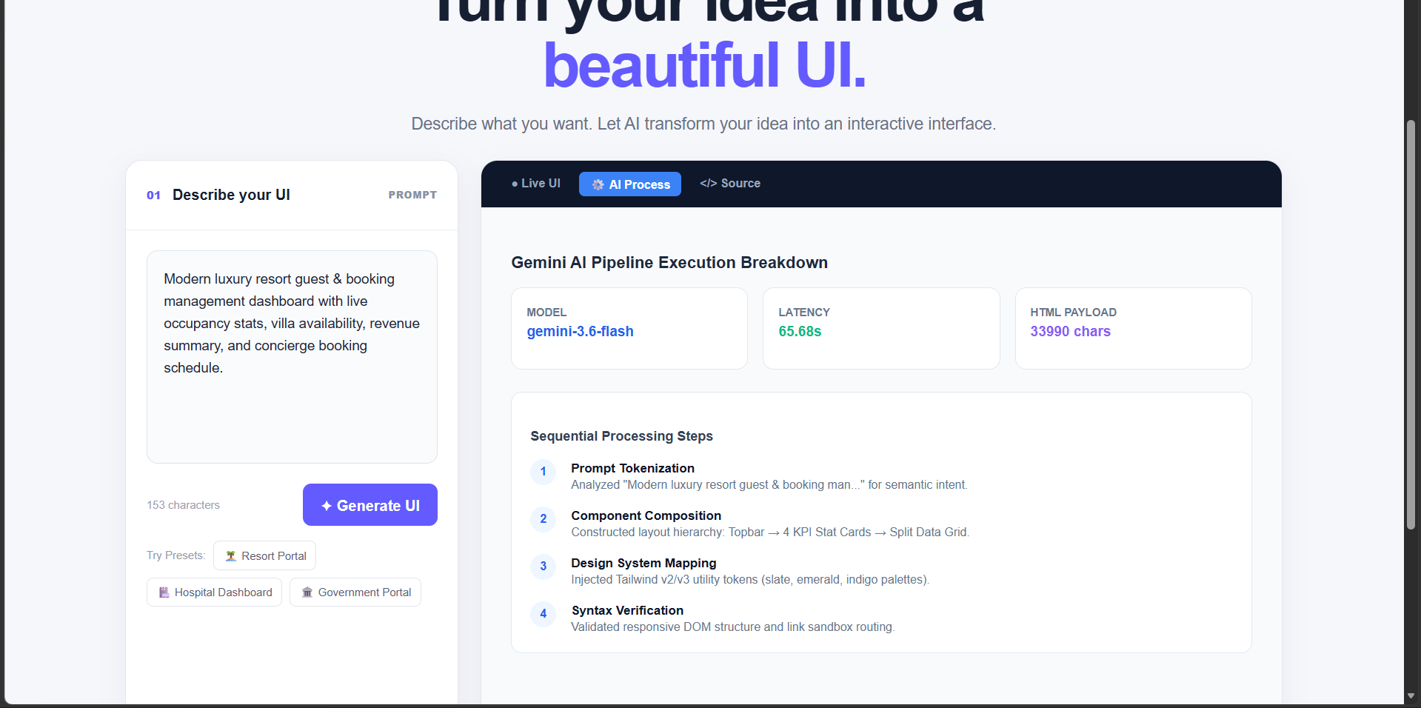
NEXUS

